Slide 1

10x CORE POINTS
FROM CHAOS TO CLARITY:
HOW ARTIFICIAL INTELLIGENCE CAN ASSIST LAW FIRMS IN DOCUMENT REVIEW

Slide 2


01
EFFICIENCY
Document review is a crucial and often time-consuming task for Law Firms.
Artificial Intelligence (AI) can greatly improve the efficiency of this process by automating many of the tasks involved

Slide 3

02
EXTRACTING
INFORMATION
One of the main ways that AI can assist with document review is by quickly identifying and extracting relevant information from large volumes of documents. This can save lawyers significant amounts of time that would otherwise be spent reading thorough ever document manually.

Slide 4

03
CLASSIFY
DOCUMENTS
AI can also be used to classify documents based on their content, making it easier for lawyers to find and review the most relevant documents

Slide 5

04
CONCISE
OVERVIEW
In addition to identifying and extracting relevant information, AI can also be used to summarise documents, providing lawyers with a concise overview of their content

Slide 6

05
CONFLICT
OF INTERESTS
Another potential use of AI in document review is in the identification of potential conflicts of interests. AI can analyse documents and identify relationships between parties, helping to ensure that a Law Firm is not representing conflicting interests

Slide 7

06
PATTERNS
SIMILAR DOCS
AI can also be used to help identify patterns and trends within sets of documents, which can be particularly useful in cases where a large number of similar documents need to be reviewed

Slide 8

07
ACCURATE
DATA
While AI can be a valuable tool in the document review process, it is important for Law Firms to carefully consider the limitation of the technology. AI is only as good as the data it is trained on, and there is a risk of biased results if the training data is not representative

Slide 9

08
EFFECTIVE
AUTOMATION
Despite these limitations, the potential benefits of AI for document review are significant. By automating many of the tasks involved, AI can help lawyers review documents more efficiently and effectively, ultimately leading to better outcomes for their clients

Slide 10

09
AI FOR
FUTURE LAW FIRM
As AI technology continues to advance, it is likely that it will play an increasingly important role in the Legal Industry, including in the Document Review Process. Law Firms that embrace AI and incorporate it into their workflows will be well positioned to take advantage of the many benefits it offers

Slide 11

10
TRANSPARENT
ACCOUNTABLE
It is important for Law Firms to carefully consider the ethical and legal implications of using AI in document review. For example, they should ensure that the use of AI is transparent and accountable, and appropriate safeguards are in place to protect client confidentiality

Slide 12
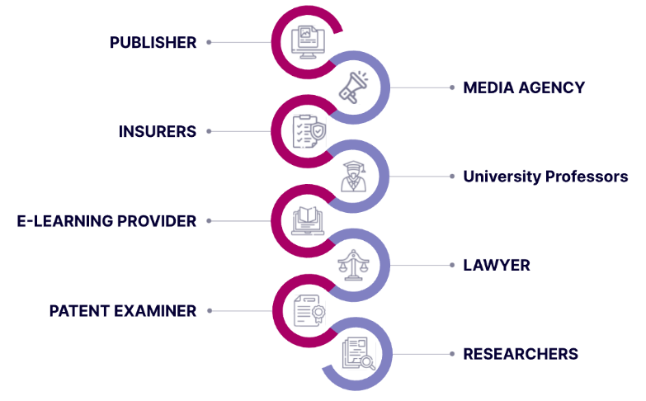
11
LET’S START NOW!
MEET US, WE CAN HELP:
https://calendly.com/danielczarnecki/virtual-coffee
https://AIdot.cloud

